Slide 1
E-Travel – how to complete the request
Some data are needed for statistical purposes by the Ministry and by the Italian Evaluation Agency (ANVUR), therefore you are kindly requested to stick to the following instrucions to fill in your Request for Travel Authorization.
1. > login at My UNITN
2. > Gestione trasferte

Slide 2
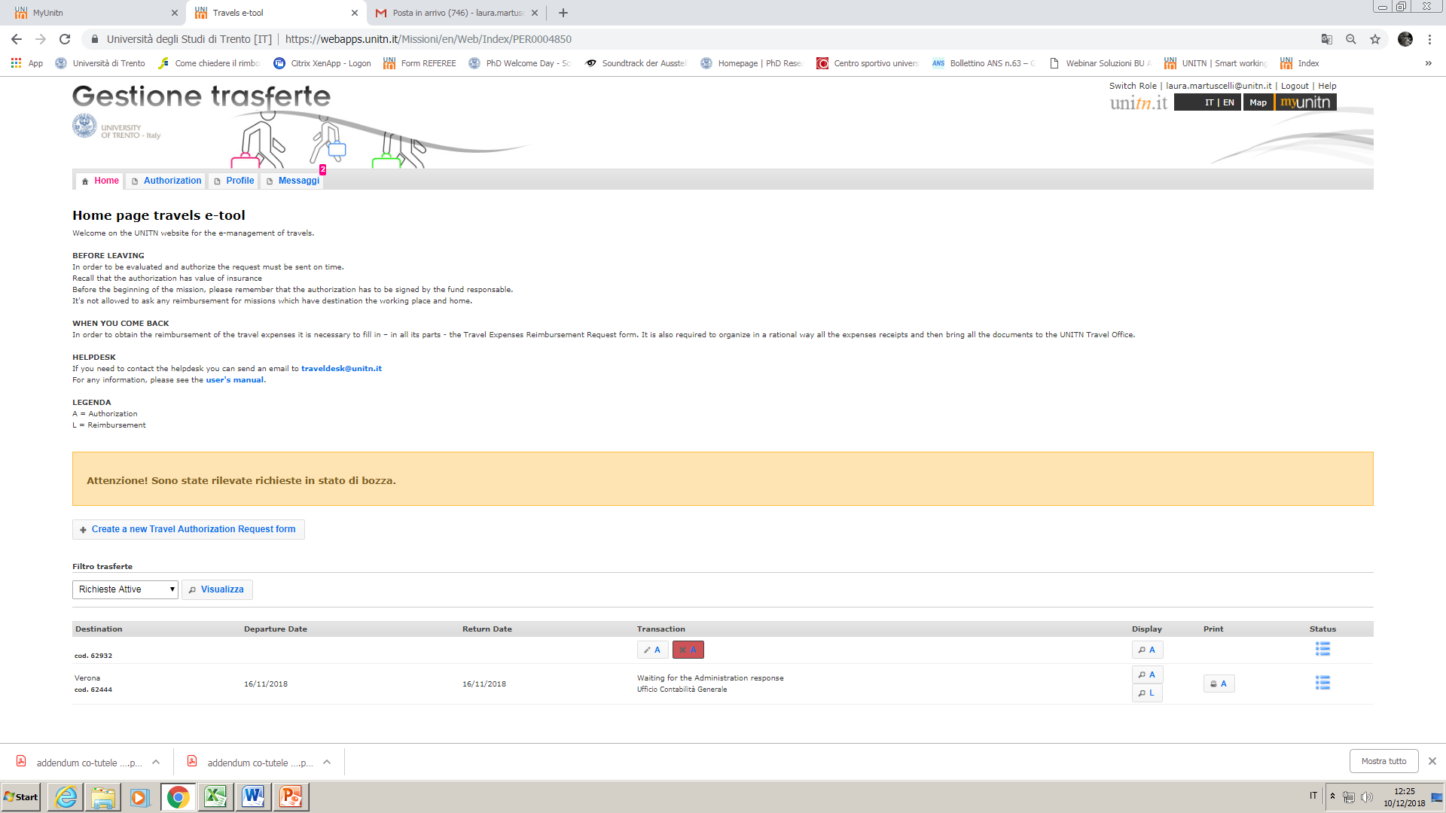
Create a new Travel Authorization

Slide 3
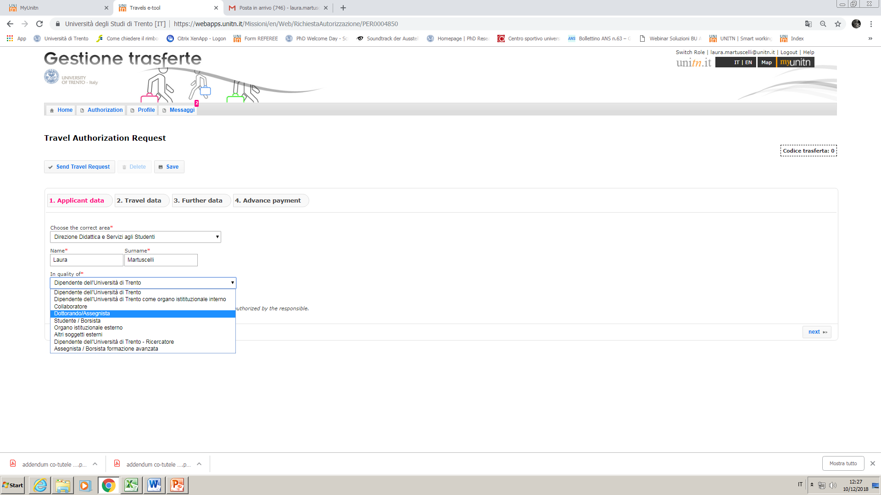
Select your role/position
i.e. Dottorando

Slide 4
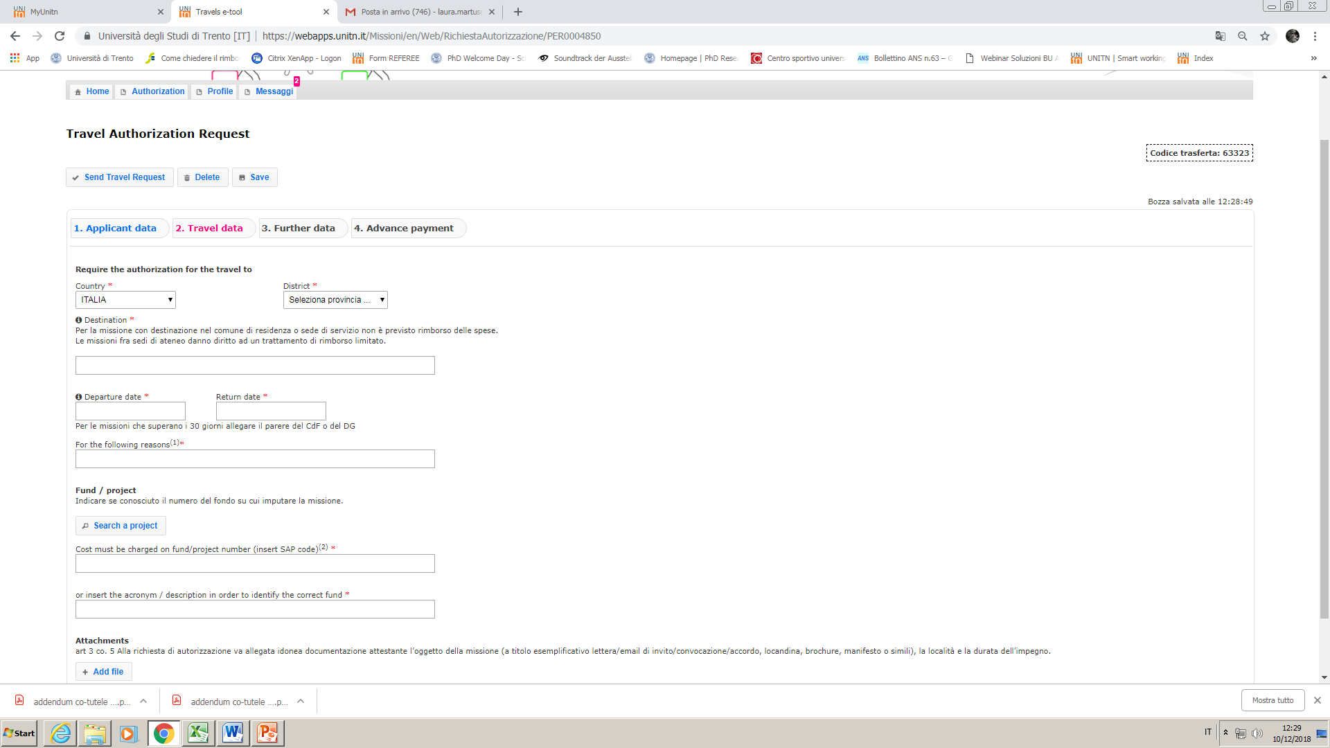
ITALY
Italian Province: choose in the list
The list includes all the Italian provinces. The Province is the main town of an administrative district.
Examples: Pergine is in the Province of Trento; Erice in the Province of Trapani.

Slide 5
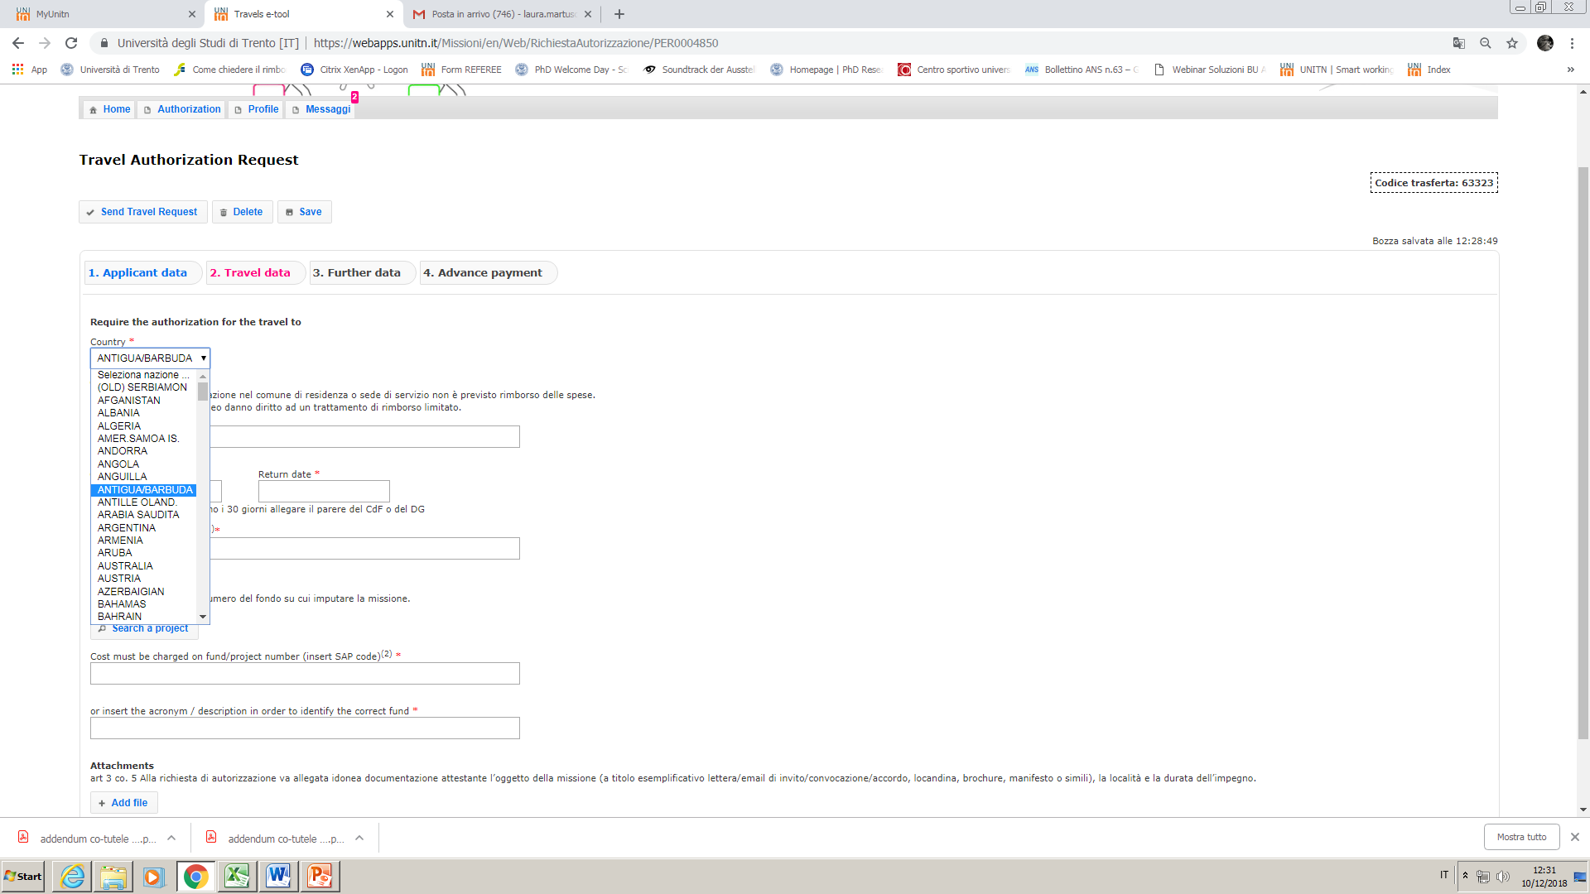
ABROAD
Choose one country from the list
(listed in Italian)

Slide 6
Box «Destination»
N.B. You cannot ask for reimbursement if the destination of your mobility is in the municipality where you have your official residence.
Fill in the box as follows: CITY – INSTITUTION
Examples:
Roma – Università «La Sapienza»
Berlin – Freie Unviersitaet Berlin
Paris – CNRS Centre national de la recherche scientifique
Verona – Azienda Ospedaliera di Borgo Trento
Cisterna - Consorzio di bonifica
Torino – FCA Fiat Crysler Automobili
Milano - Politecnico
N.B. : In case of Conferences, Summer schools, Workshops etc. , if the hosting institution/location is different from the organizing institution, write the organizing institution instead.
Example: Erice – Associazione Internazionale di Astrofisica - Convegno di astrofisica 2008

Slide 7
Dates
The dates of start and return MUST refer to the actual dates you leave and return (for insurance purposes). If you leave in advance (or return later) for personal reasons with respect to the period of mobility (duration of the research period, conference, etc.) you must specify it in the box «For the following reasons».
Example: EUREGIO – Conference «Borders beyond borders» - The days 23-25 april I will remain for personal reasons.

Slide 8
Box «For the following reasons»
Clearly specify the motivation.
Examples:
Conference « IDRAPOWER 2018» and poster presentation
Summer School «Maths on the rocks»
Research period at the Experimental laboratory
Field research /Ricerca su campo / Ricerca in azienda
Stage/Internship
In case of a mobility within a specific project ALWAYS quote it as the first information.
Examples:
EUREGIO – Conference «Borders beyond borders»
ERASMUS – Mobility research period at the partner institution
MSCA – Mandatory secondment to the partner organization
PRIN – riunione per presentazione risultati
CO-TUTELA – Research period at the partner institution
H2020 – EUROFLOW project – Kiock-off meeting

Slide 9
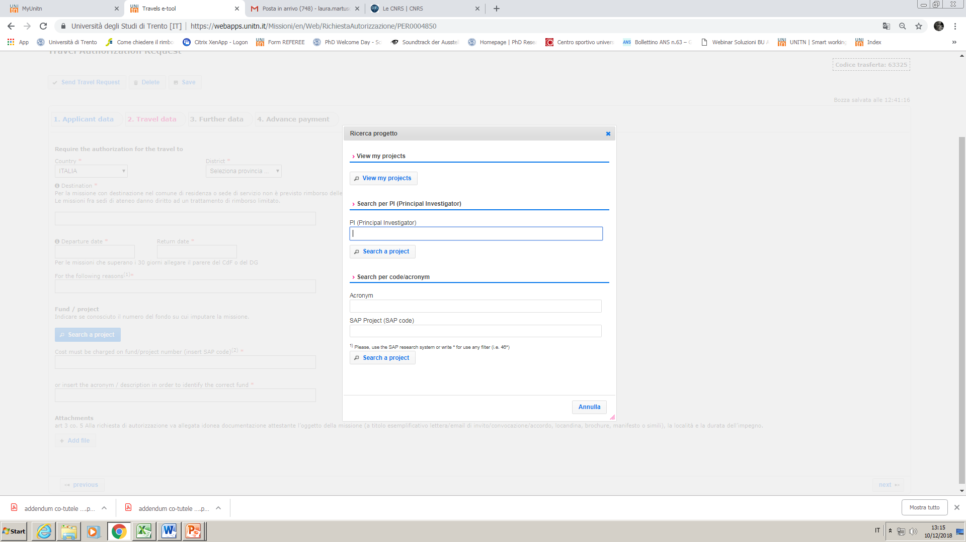
Fund/Project
2a View my projects
OR
2b Name of Supervisor
1. Search a project

Slide 10
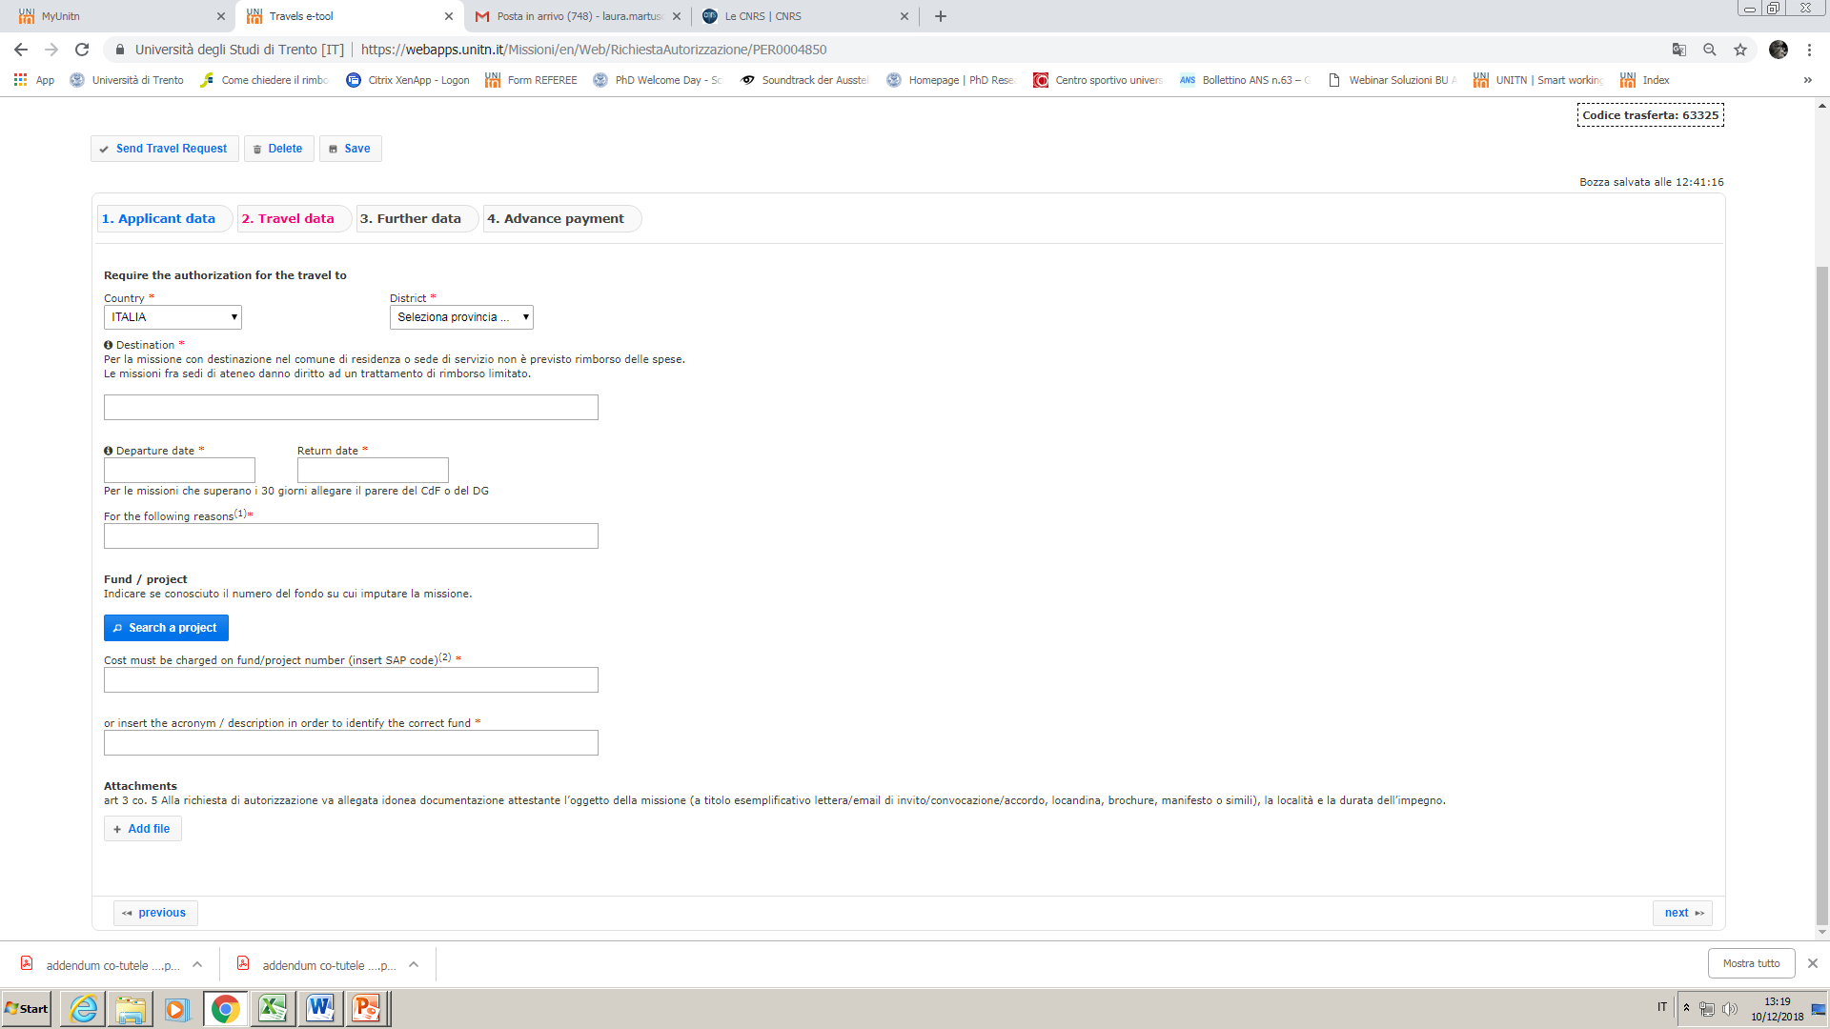
Attachments
Always upload something (i.e. the Conference programme, mail of invitation, Erasmus mail, etc.)

Slide 11
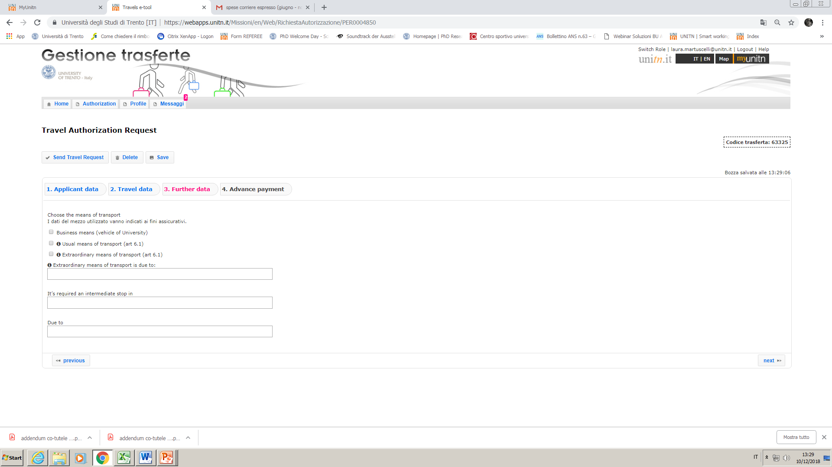
Means
1. Usual means: train, bus, airplane, car up to km 700 (return included)
In case of car-sharing specify the names of other students/professors coming with you in the Extraordinary means … box

Slide 12
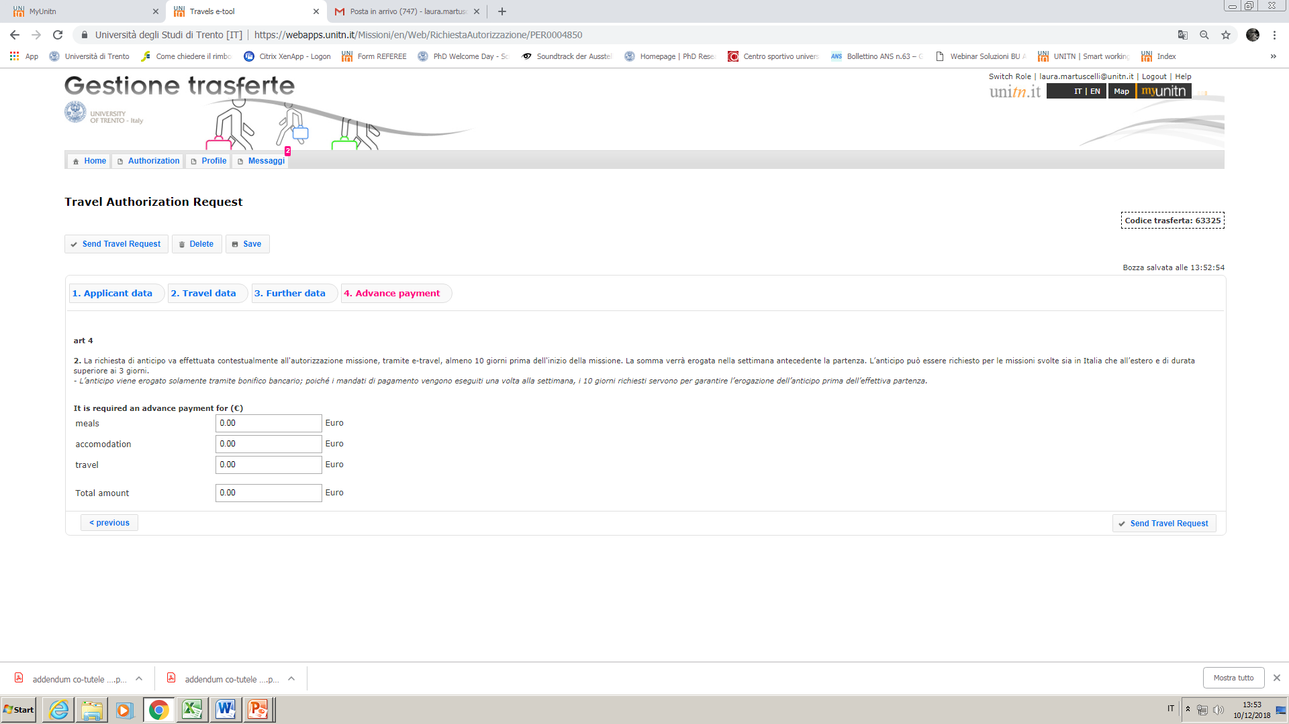
Advance payment it may be asked for at least 10 days before departure
Last step: Send request

